Slide 1
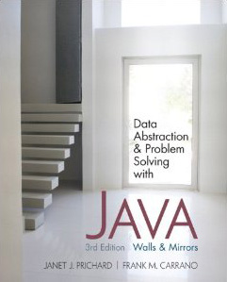
Chapter 3
Recursion: The Mirrors
© 2011 Pearson Addison-Wesley. All rights reserved
3-<number>

Slide 2
Recursive Solutions
Recursion
  An extremely powerful problem-solving technique
  Breaks a problem in smaller identical problems
  An alternative to iteration
    An iterative solution involves loops
© 2011 Pearson Addison-Wesley. All rights reserved
3-<number>

Slide 3
Recursive Solutions
Sequential search
  Starts at the beginning of the collection
  Looks at every item in the collection in order until the item being searched for is found
Binary search
  Repeatedly halves the collection and determines which half could contain the item
  Uses a divide and conquer strategy
© 2011 Pearson Addison-Wesley. All rights reserved
3-<number>

Slide 4
Recursive Solutions
Facts about a recursive solution
  A recursive method calls itself
  Each recursive call solves an identical, but smaller, problem
  A test for the base case enables the recursive calls to stop
    Base case: a known case in a recursive definition
  Eventually, one of the smaller problems must be the base case
© 2011 Pearson Addison-Wesley. All rights reserved
3-<number>

Slide 5
Recursive Solutions
Four questions for construction recursive solutions
  How can you define the problem in terms of a smaller problem of the same type?
  How does each recursive call diminish the size of the problem?
  What instance of the problem can serve as the base case?
  As the problem size diminishes, will you reach this base case?
© 2011 Pearson Addison-Wesley. All rights reserved
3-<number>

Slide 6
A Recursive Valued Method:
The Factorial of n
Problem
  Compute the factorial of an integer n
An iterative definition of factorial(n)
  factorial(n) = n * (n-1) * (n-2) * … * 1
  for any integer n > 0
  factorial(0) = 1
© 2011 Pearson Addison-Wesley. All rights reserved
3-<number>

Slide 7
A Recursive Valued Method:
The Factorial of n
A recursive definition of factorial(n)
  factorial(n) = 1 if n = 0
  n * factorial(n-1) if n > 0
A recurrence relation
  A mathematical formula that generates the terms in a sequence from previous terms
  Example
  factorial(n) = n * [(n-1) * (n-2) * … * 1]
  = n * factorial(n-1)
© 2011 Pearson Addison-Wesley. All rights reserved
3-<number>

Slide 8
A Recursive Valued Method:
The Factorial of n
Box trace
  A systematic way to trace the actions of a recursive method
  Each box roughly corresponds to an activation record
  An activation record
    Contains a method’s local environment at the time of and as a result of the call to the method
© 2011 Pearson Addison-Wesley. All rights reserved
3-<number>

Slide 9
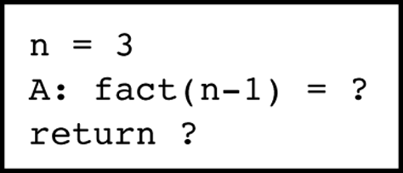
A Recursive Valued Method:
The Factorial of n
A method’s local environment includes:
  The method’s local variables
  A copy of the actual value arguments
  A return address in the calling routine
  The value of the method itself
Figure 3-3
A box
© 2011 Pearson Addison-Wesley. All rights reserved
3-<number>

Slide 10
A Recursive void Method: Writing a String Backward
Problem
  Given a string of characters, write it in reverse order
Recursive solution
  Each recursive step of the solution diminishes by 1 the length of the string to be written backward
  Base case
    Write the empty string backward
© 2011 Pearson Addison-Wesley. All rights reserved
3-<number>

Slide 11
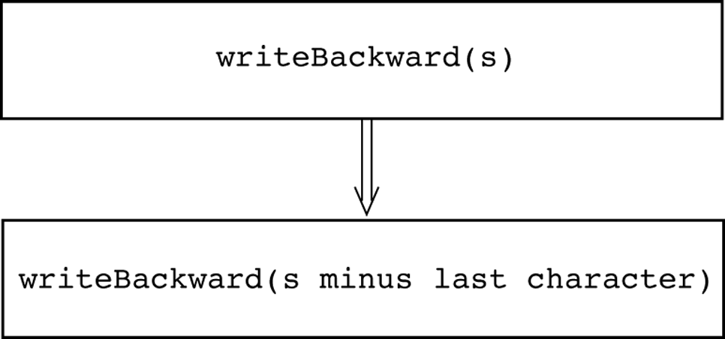
A Recursive void Method: Writing a String Backward
Figure 3-6
A recursive solution
© 2011 Pearson Addison-Wesley. All rights reserved
3-<number>

Slide 12
A Recursive void Method: Writing a String Backward
Execution of writeBackward can be traced using the box trace
Temporary System.out.println statements can be used to debug a recursive method
© 2011 Pearson Addison-Wesley. All rights reserved
3-<number>

Slide 13
Counting Things
Next three problems
  Require you to count certain events or combinations of events or things
  Contain more than one base cases
  Are good examples of inefficient recursive solutions
© 2011 Pearson Addison-Wesley. All rights reserved
3-<number>

Slide 14
Multiplying Rabbits
(The Fibonacci Sequence)
“Facts” about rabbits
  Rabbits never die
  A rabbit reaches sexual maturity exactly two months after birth, that is, at the beginning of its third month of life
  Rabbits are always born in male-female pairs
    At the beginning of every month, each sexually mature male-female pair gives birth to exactly one male-female pair
© 2011 Pearson Addison-Wesley. All rights reserved
3-<number>

Slide 15
Multiplying Rabbits
(The Fibonacci Sequence)
Problem
  How many pairs of rabbits are alive in month n?
Recurrence relation
  rabbit(n) = rabbit(n-1) + rabbit(n-2)
© 2011 Pearson Addison-Wesley. All rights reserved
3-<number>

Slide 16
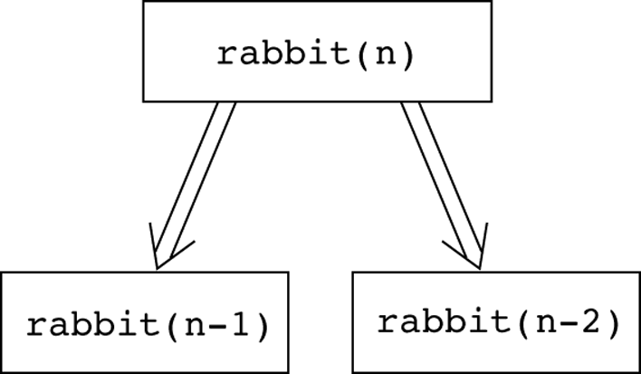
Multiplying Rabbits
(The Fibonacci Sequence)
Figure 3-10
Recursive solution to the rabbit problem
© 2011 Pearson Addison-Wesley. All rights reserved
3-<number>

Slide 17
Multiplying Rabbits
(The Fibonacci Sequence)
Base cases
  rabbit(2), rabbit(1)
Recursive definition
  rabbit(n) = 1 if n is 1 or 2
  rabbit(n-1) + rabbit(n-2) if n > 2
Fibonacci sequence
  The series of numbers rabbit(1), rabbit(2), rabbit(3), and so on
© 2011 Pearson Addison-Wesley. All rights reserved
3-<number>

Slide 18
Organizing a Parade
Rules about organizing a parade
  The parade will consist of bands and floats in a single line
  One band cannot be placed immediately after another
Problem
  How many ways can you organize a parade of length n?
© 2011 Pearson Addison-Wesley. All rights reserved
3-<number>

Slide 19
Organizing a Parade
Let:
  P(n) be the number of ways to organize a parade of length n
  F(n) be the number of parades of length n that end with a float
  B(n) be the number of parades of length n that end with a band
Then
  P(n) = F(n) + B(n)
© 2011 Pearson Addison-Wesley. All rights reserved
3-<number>

Slide 20
Organizing a Parade
Number of acceptable parades of length n that end with a float
  F(n) = P(n-1)
Number of acceptable parades of length n that end with a band
  B(n) = F(n-1)
Number of acceptable parades of length n
  P(n) = P(n-1) + P(n-2)
© 2011 Pearson Addison-Wesley. All rights reserved
3-<number>

Slide 21
Organizing a Parade
Base cases
  P(1) = 2 (The parades of length 1 are float and band.)
  P(2) = 3 (The parades of length 2 are float-float, band- float, and float-band.)
Solution
  P(1) = 2
  P(2) = 3
  P(n) = P(n-1) + P(n-2) for n > 2
© 2011 Pearson Addison-Wesley. All rights reserved
3-<number>

Slide 22
Mr. Spock’s Dilemma
(Choosing k out of n Things)
Problem
  How many different choices are possible for exploring k planets out of n planets in a solar system?
Let
  c(n, k) be the number of groups of k planets chosen from n
© 2011 Pearson Addison-Wesley. All rights reserved
3-<number>

Slide 23
Mr. Spock’s Dilemma
(Choosing k out of n Things)
In terms of Planet X:
  c(n, k) = (the number of groups of k planets that include Planet X)
  +
  (the number of groups of k planets that do not include Planet X)
© 2011 Pearson Addison-Wesley. All rights reserved
3-<number>

Slide 24
Mr. Spock’s Dilemma
(Choosing k out of n Things)
The number of ways to choose k out of n things is the sum of
  The number of ways to choose k-1 out of n-1 things
  and
  The number of ways to choose k out of n-1 things
c(n, k) = c(n-1, k-1) + c(n-1, k)
© 2011 Pearson Addison-Wesley. All rights reserved
3-<number>

Slide 25
Mr. Spock’s Dilemma
(Choosing k out of n Things)
Base cases
  There is one group of everything
  c(k, k) = 1
  There is one group of nothing
  c(n, 0) = 1
  c(n, k) = 0 if k > n
© 2011 Pearson Addison-Wesley. All rights reserved
3-<number>

Slide 26
Mr. Spock’s Dilemma
(Choosing k out of n Things)
Recursive solution
  1 if k = 0
  c(n, k) = 1 if k = n
  0 if k > n
  c(n-1, k-1) + c(n-1, k) if 0 < k < n
© 2011 Pearson Addison-Wesley. All rights reserved
3-<number>

Slide 27
Searching an Array:
Finding the Largest Item in an Array
A recursive solution
  if (anArray has only one item) {
  maxArray(anArray) is the item in anArray
  }
  else if (anArray has more than one item) {
  maxArray(anArray) is the maximum of
  maxArray(left half of anArray) and
  maxArray(right half of anArray)
  } // end if
© 2011 Pearson Addison-Wesley. All rights reserved
3-<number>

Slide 28
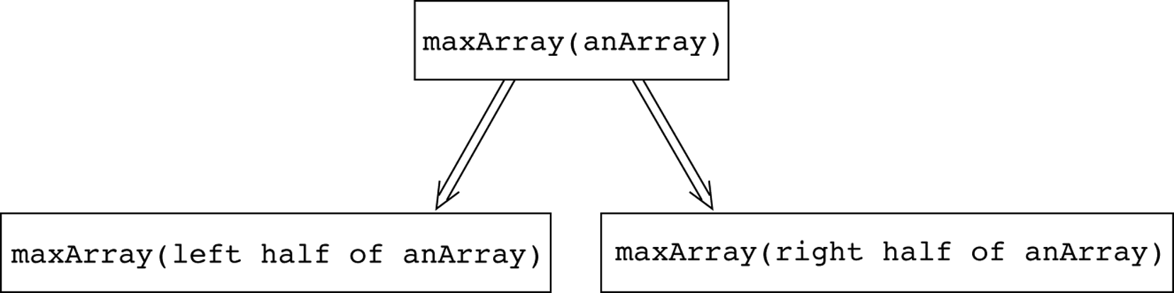
Finding the Largest Item in an Array
Figure 3-13
Recursive solution to the largest-item problem
© 2011 Pearson Addison-Wesley. All rights reserved
3-<number>

Slide 29
Binary Search
A high-level binary search
  if (anArray is of size 1) {
  Determine if anArray’s item is equal to value
  }
  else {
  Find the midpoint of anArray
  Determine which half of anArray contains value
  if (value is in the first half of anArray) {
  binarySearch (first half of anArray, value)
  }
  else {
  binarySearch(second half of anArray, value)
  } // end if
  } // end if
© 2011 Pearson Addison-Wesley. All rights reserved
3-<number>

Slide 30
Binary Search
Implementation issues:
  How will you pass “half of anArray” to the recursive calls to binarySearch?
  How do you determine which half of the array contains value?
  What should the base case(s) be?
  How will binarySearch indicate the result of the search?
© 2011 Pearson Addison-Wesley. All rights reserved
3-<number>

Slide 31
Finding the k^{th} Smallest Item in an Array
The recursive solution proceeds by:
  Selecting a pivot item in the array
  Cleverly arranging, or partitioning, the items in the array about this pivot item
  Recursively applying the strategy to one of the partitions
© 2011 Pearson Addison-Wesley. All rights reserved
3-<number>

Slide 32
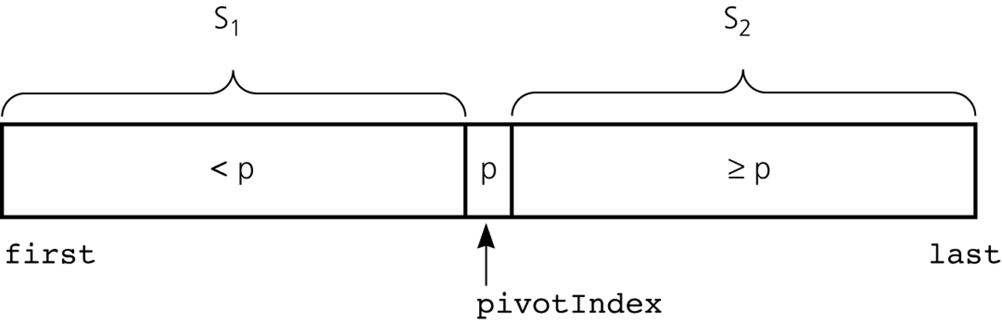
Finding the k^{th} Smallest Item in an Array
Figure 3-18
A partition about a pivot
© 2011 Pearson Addison-Wesley. All rights reserved
3-<number>

Slide 33
Finding the k^{th} Smallest Item in an Array
Let:
  kSmall(k, anArray, first, last) =
  k^{th} smallest item in anArray[first..last]
Solution:
  kSmall(k, anArray, first, last)
  kSmall(k, anArray, first, pivotIndex-1)
  if k < pivotIndex – first + 1
  = if k = pivotIndex – first + 1
  p
  kSmall(k-(pivotIndex-first+1), anArray,
  pivotIndex+1, last)
  if k > pivotIndex – first + 1
© 2011 Pearson Addison-Wesley. All rights reserved
3-<number>

Slide 34
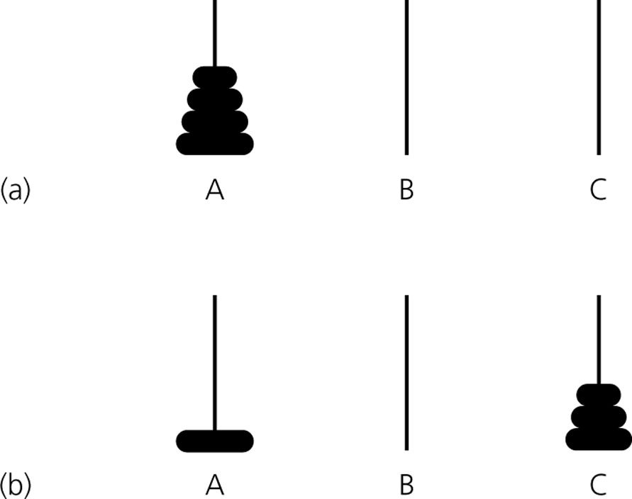
Organizing Data:
The Towers of Hanoi
Figure 3-19a and b
a) The initial state; b) move n - 1 disks from A to C
© 2011 Pearson Addison-Wesley. All rights reserved
3-<number>

Slide 35
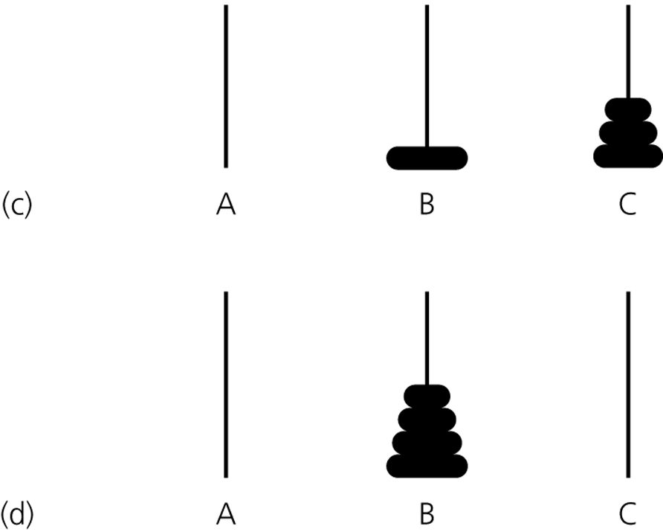
The Towers of Hanoi
Figure 3-19c and d
c) move one disk from A to B; d) move n - 1 disks from C to B
© 2011 Pearson Addison-Wesley. All rights reserved
3-<number>

Slide 36
The Towers of Hanoi
Pseudocode solution
  solveTowers(count, source, destination, spare)
  if (count is 1) {
  Move a disk directly from source to destination
  }
  else {
  solveTowers(count-1, source, spare, destination)
  solveTowers(1, source, destination, spare)
  solveTowers(count-1, spare, destination, source)
  } //end if
© 2011 Pearson Addison-Wesley. All rights reserved
3-<number>

Slide 37
Recursion and Efficiency
Some recursive solutions are so inefficient that they should not be used
Factors that contribute to the inefficiency of some recursive solutions
  Overhead associated with method calls
  Inherent inefficiency of some recursive algorithms
© 2011 Pearson Addison-Wesley. All rights reserved
3-<number>

Slide 38
Summary
Recursion solves a problem by solving a smaller problem of the same type
Four questions to keep in mind when constructing a recursive solution
  How can you define the problem in terms of a smaller problem of the same type?
  How does each recursive call diminish the size of the problem?
  What instance of the problem can serve as the base case?
  As the problem size diminishes, will you reach this base case?
© 2011 Pearson Addison-Wesley. All rights reserved
3-<number>

Slide 39
Summary
A recursive call’s postcondition can be assumed to be true if its precondition is true
The box trace can be used to trace the actions of a recursive method
Recursion can be used to solve problems whose iterative solutions are difficult to conceptualize
© 2011 Pearson Addison-Wesley. All rights reserved
3-<number>

Slide 40
Summary
Some recursive solutions are much less efficient than a corresponding iterative solution due to their inherently inefficient algorithms and the overhead of method calls
If you can easily, clearly, and efficiently solve a problem by using iteration, you should do so
© 2011 Pearson Addison-Wesley. All rights reserved
3-<number>

